Slide 1

GidiAI — a Cactus Digital Media project
October 2026 | US$25k
GIDI AI
PITCH DECK
Lagos, Nigeria
www.cactusdigitalmedia.ng

Slide 2


THE PROBLEM: AFRICAN MOBILITY IS AN INFORMATION PROBLEM
Formal and informal transport networks are deeply fragmented.
Routes, fares, stops and transfers rely on unwritten local knowledge.
Commuters juggle multiple disconnected tools to plan a single trip.
Expensive ride-hailing becomes the default when information fails.
No single platform connects the full multimodal Lagos journey.
The gap is not infrastructure — it is accessible, real-time intelligence.
In Lagos, a typical commute may involve BRT, danfo minibuses, keke napep and walking — each with its own undocumented rules. Without local knowledge, commuters overpay, get lost or simply give up and book a ride-hail. The information problem costs time, money and opportunity every single day.

Slide 3
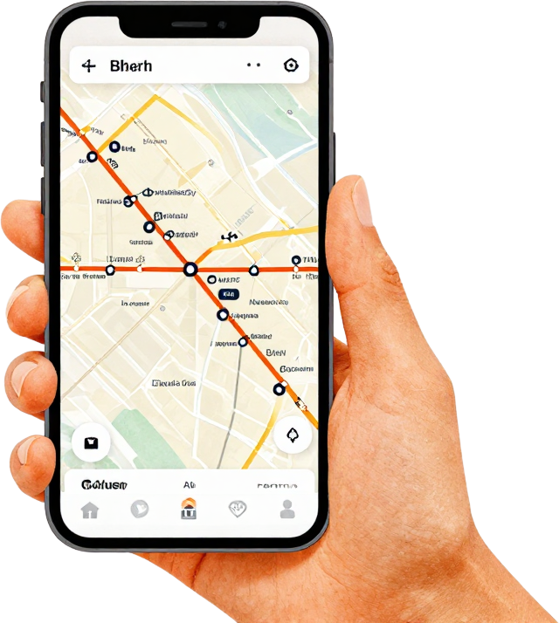
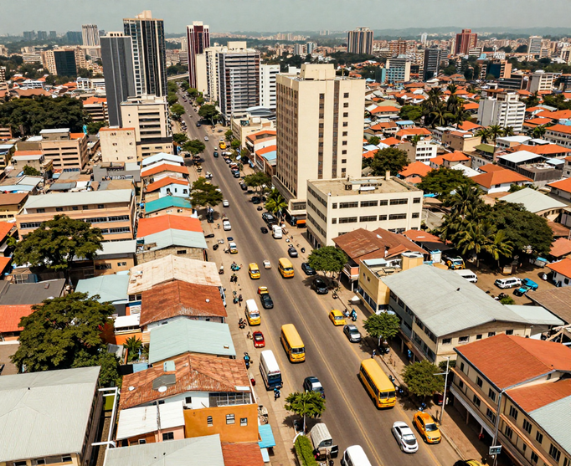
THE OPPORTUNITY
Lagos has a large, complex multimodal mobility market. Formal routes and informal operators often lack a single dependable route-and-fare information layer. GidiAI targets this gap, starting with field validation.
The proposed WhatsApp-led service would test whether verified local stop, route and fare data improves journey planning. Market size and willingness to pay still require primary research.
Problem Indicators (qualitative)
A massive, underserved mobility economy already in motion
Lagos-first commuter problem
Mixed BRT, danfo, keke and walking
Informal route and fare data gaps
Field-led accuracy testing planned

Slide 4
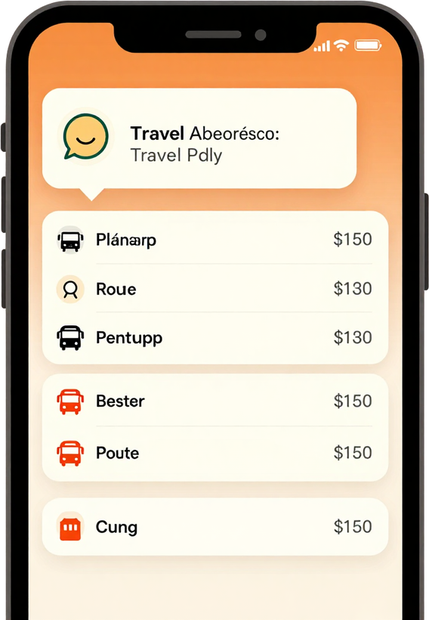
ASK GIDIAI
HOW TO GET THERE
A user would ask for a route in plain language on WhatsApp. The MVP will test whether validated local information can produce useful step-by-step options without an app download.
The intended product compares BRT, danfo, keke and walking legs, with estimated fares and transfers. Route coverage, reliability and time estimates must be validated in a controlled Lagos pilot.

Slide 5



GidiAI is designed around the real transport ecosystem — not just the formal one. From BRT corridors to danfo routes, keke stops to walking paths, GidiAI combines formal and informal networks into a single, intelligent mobility layer.
BUILT FOR HOW AFRICA ACTUALLY MOVES
BRT + Buses + Danfo
Keke + Bikes + Walking
Formal & informal routes
Last-mile connections
Ride-hailing + Multimodal
Dynamic Local Knowledge
Cost & time optimised
Price-sensitive decisions

Slide 6


AI IS THE
INTERFACE
Mobility Graph
Conversational AI
A proposed mobility graph would map stops, routes, operators, fares and transfers. Field collection and updates are key milestones, not completed citywide coverage.
Conversational AI would translate journeys into structured route queries. Pilot feedback should test clarity, route accuracy and fare reliability before scaling.

Slide 7


WHY
NOW.
WHY
NOW.
African cities are expanding faster than transport infrastructure can keep up.
Mobility remains fragmented — no single tool connects the full journey.
Conversational AI can now reason over complex, multi-step route decisions.
WhatsApp eliminates app-download friction — users are already there.
Smartphone penetration and connectivity unlock distribution at scale.
The conditions for an AI mobility layer in Africa have never been stronger.

Slide 8

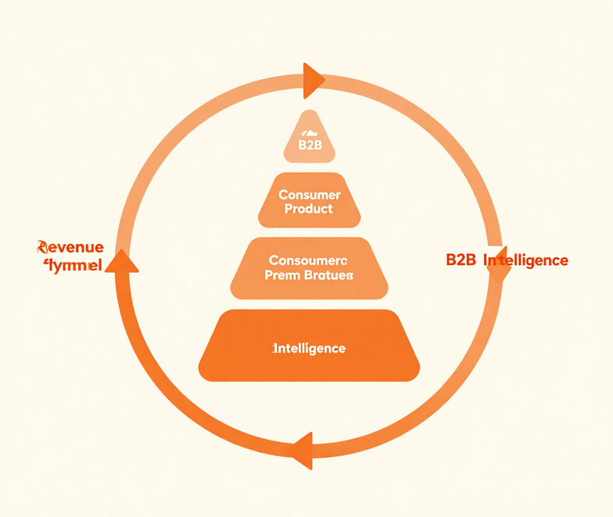
Potential model: free route guidance, then optional premium commuter alerts and operator referrals if uptake, payments and partnerships are validated. No revenue is claimed.
Later options: employer route intelligence, B2B analytics and APIs. Each depends on verified demand, suitable data rights and signed commercial agreements.
BUSINESS
MODEL
BUSINESS
MODEL

Slide 9

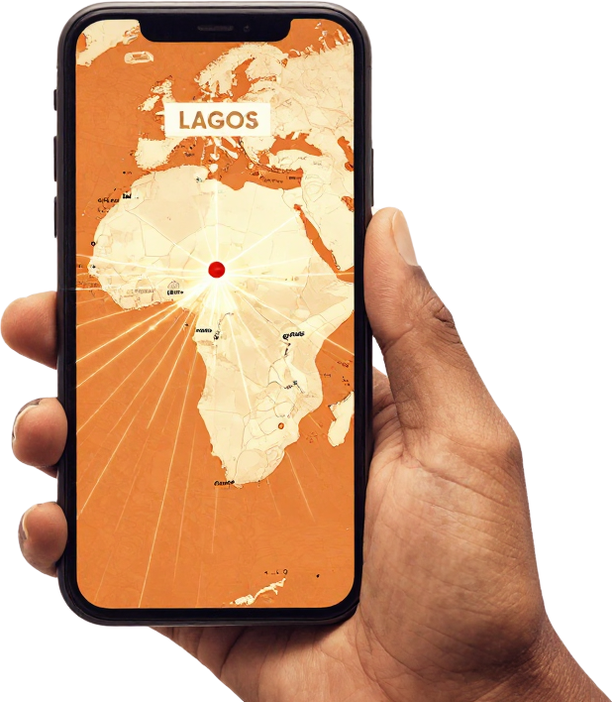
Proposed pilot in selected Lagos corridors: collect route/fare ground truth, test with commuter volunteers and iterate on accuracy. Community outreach is budgeted; partnerships are not yet signed.
Expand beyond Lagos only after meeting clear pilot targets for route reliability, repeat use and cost per query. No current user traction or transport partnerships are claimed.
Our Strategy
Disciplined wedge: Lagos first, Africa next
Founder-led launch in Lagos commuter corridors
Commuter communities & organic referrals
Transport operator & community partnerships
Validate repeat usage, accuracy & retention
Expand to Abuja, Port Harcourt & Ibadan
Scale to Accra, Nairobi & beyond
GO-TO-MARKET
& EXPANSION

Slide 10

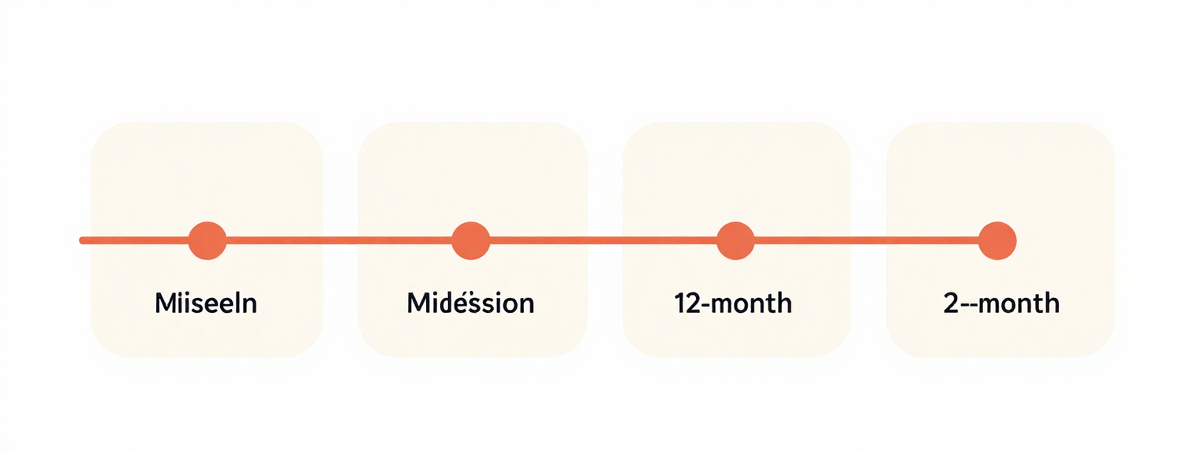
ROADMAP &
MILESTONES
0–3 months: build/verify MVP and initial Lagos data.
4–6: controlled commuter testing; measure route/fare accuracy and repeat use.
7–9: pilot revenue/partner hypotheses; verify willingness to pay.
10–12: decide scale readiness based on pilot evidence.
The proposed $25K round supports a lean 12-month Lagos validation. Current stage: pre-pilot; no production users, revenue or confirmed partnerships. Milestones are targets, not achieved results.

Slide 11


Osagie Bernard Ebhuomhan is a software engineer, product builder, and entrepreneur with years of experience building digital products in Nigeria. He brings full-stack engineering, cloud infrastructure, and AI-enabled product development to GidiAI — building from Lagos, for Lagos.
THE FOUNDER
Founder & CEO
Core expertise
Osagie B. Ebhuomhan
Full-stack & Cloud Engineering
Product & Technical Leadership
Background
AI-enabled Product Development
Built in Lagos, Nigeria

Slide 12


THE
RAISE
Use of Funds
12-Month Objective
Field data $6k · Engineering $5k · AI/cloud/maps $4k · Pilot research $3k · Outreach $2.5k · Ops/legal $2.5k · Contingency $2k. Proposed, not vendor quotes.
Pre-pilot target: validate local route/fare accuracy, repeat commuter use and viable service economics before expanding.

Slide 13

GidiAI
October 2026
GIDIAI
Lagos-first WhatsApp mobility intelligence. Seeking US$25,000 for a lean, evidence-driven 12-month pilot. No production traction claimed.
info@cactusdigitalmedia.ng
cactusdigitalmedia.ng

