Slide 1


October 2026 | US$25,000 pre-seed
WhatsApp-first giving. Trust built in.
AURA: Human Generosity, Amplified

Slide 2

The Challenge of Asking
Navigating the complexities of fundraising creates stress and confusion for both fundraisers and donors, complicating genuine connections.

Slide 3

The Generosity Economy
Millions rely on informal fundraising; AURA digitizes this behavior, transforming everyday generosity into a scalable solution for Africa.

Slide 4

The AURA Experience
AURA aims to turn a WhatsApp conversation into a structured campaign, with evidence review and approved donor checkout before launch.

Slide 5

How AURA Works
Understanding the journey from need to donation
Identify Needs
Structure Campaigns
Build Trust
AURA starts by understanding the user's need for assistance, ensuring that the urgency and details are clearly communicated through natural conversation.
The platform then helps to structure the fundraising campaign by organizing the narrative, ensuring clarity, and leveraging media inputs like voice notes and images.
Proposed trust layers combine identity checks, evidence signals and human review. No campaign is automatically guaranteed genuine.

Slide 6
Trust as a Moat
Building confidence through evidence and verification
Person
Claim
Evidence
Identity checks establish who is raising funds, subject to an approved provider. Identity alone cannot establish the truth of a claim.
Claims are reviewed against supporting documents and context. Uncertain or sensitive cases are escalated to people, not decided by AI alone.
Planned OCR, duplicate checks and media signals support review. Altered metadata and synthetic files are risks; no automated check proves authenticity.

Slide 7

Competitive Advantages of AURA
Challenges in Current Landscape
  WhatsApp-first campaign intake
  AI-assisted drafting with guardrails
  Identity, claim, evidence and payment controls
  Human review for higher-risk cases
  Africa-first donation journeys
  Fragmented fundraising platforms
  Lack of trust mechanisms
  Difficulty in campaign visibility
  High donor churn rates
  Inadequate support for local causes

Slide 8
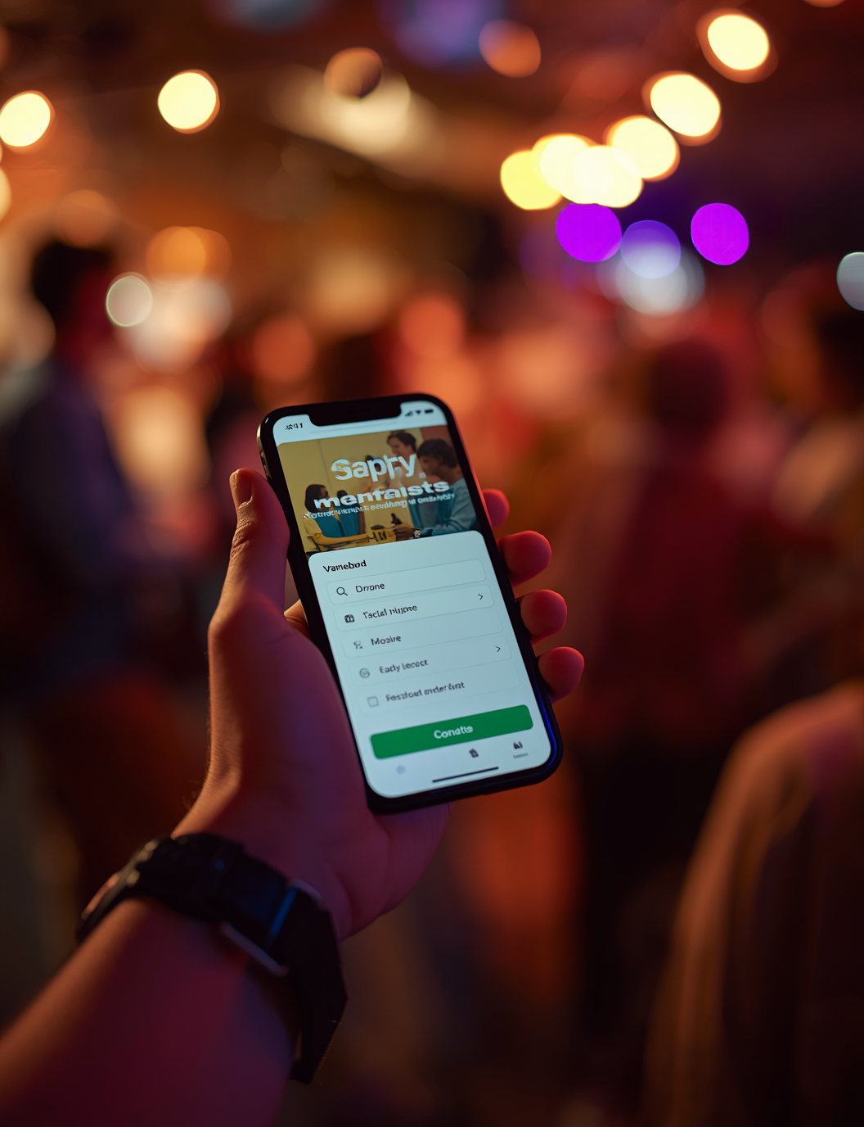
Business Model
Proposed model: modest fees on successful donations, with optional partner services later. Pricing, margins and payment flows remain subject to legal and provider approval.

Slide 9

12-Month Milestones
0–3: legal/provider diligence + MVP. 4–6: trust operations + pilot setup. 7–9: controlled testing if approved. 10–12: evaluate safety, usage and costs.

Slide 10

Go-to-Market Strategy
Pre-pilot today: no live donors, donations, revenue, licences or payment partnerships claimed. Nigeria-first invite-only pilot follows legal and provider clearance.

Slide 11
Pre-seed funding requested
Pilot and execution plan
US$25,000
12 months
Proposed: legal/provider $5k · trust ops $4k · AI/cloud $3.5k · payment testing $3k.
Proposed: pilot/support $4.5k · research $2.5k · QA/contingency $2.5k. Founder contributes engineering.

Slide 12
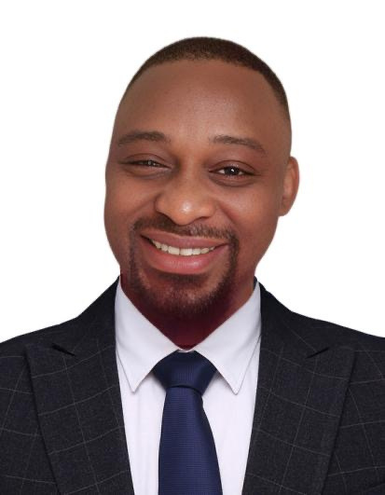
Founder: Osagie Bernard Ebhuomhan
Experienced Tech Entrepreneur and Innovator
Founder & Lead Engineer | Cactus Digital Media

Slide 13

The AURA Investment Case
Pre-pilot | US$25,000 to test trustworthy giving

